Slide 1



Ionic5
Online Workshop
12&13 Nov 2020
9am-12noon
Google Meet

Slide 2
Ionic5
Online Workshop
12&13 Nov 2020
9am-12noon
Google Meet

Slide 3

Slides & materials github.com/khirulnizam/ionic5

Slide 4
Ionic T01 Intro

Slide 5
OVERVIEW
TO IONIC FRAMEWORK

Slide 6

What is Ionic?
Ionic Framework is an open source UI toolkit for building performant, high-quality mobile and desktop apps using web technologies (HTML, CSS, and JavaScript).

Slide 7
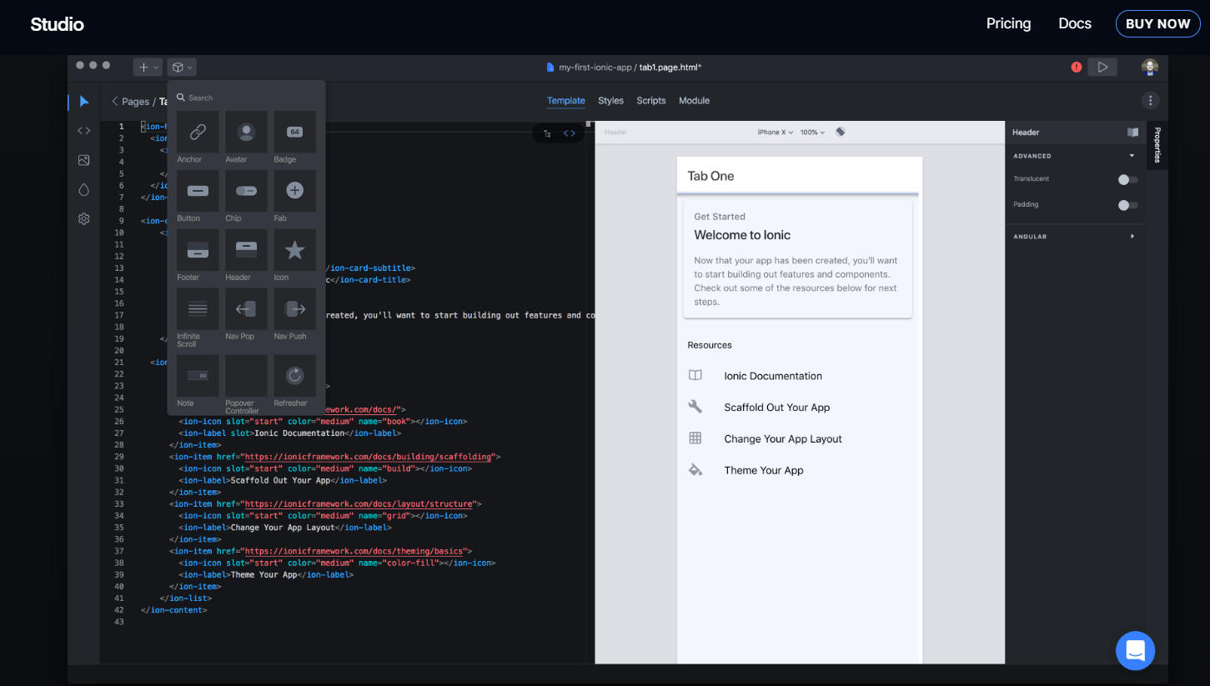
Ionic Studio

Slide 8
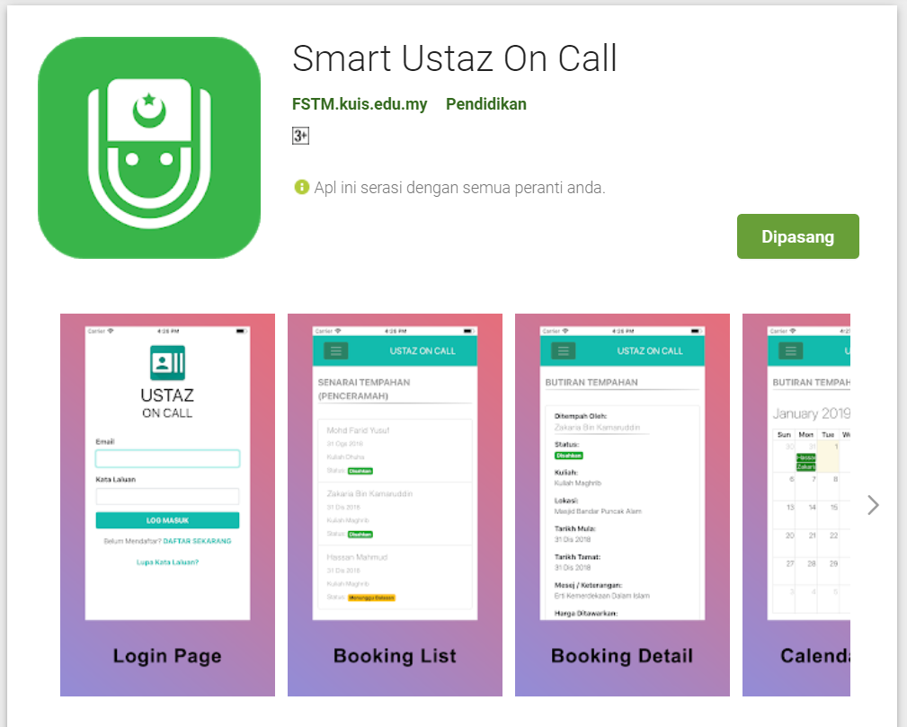
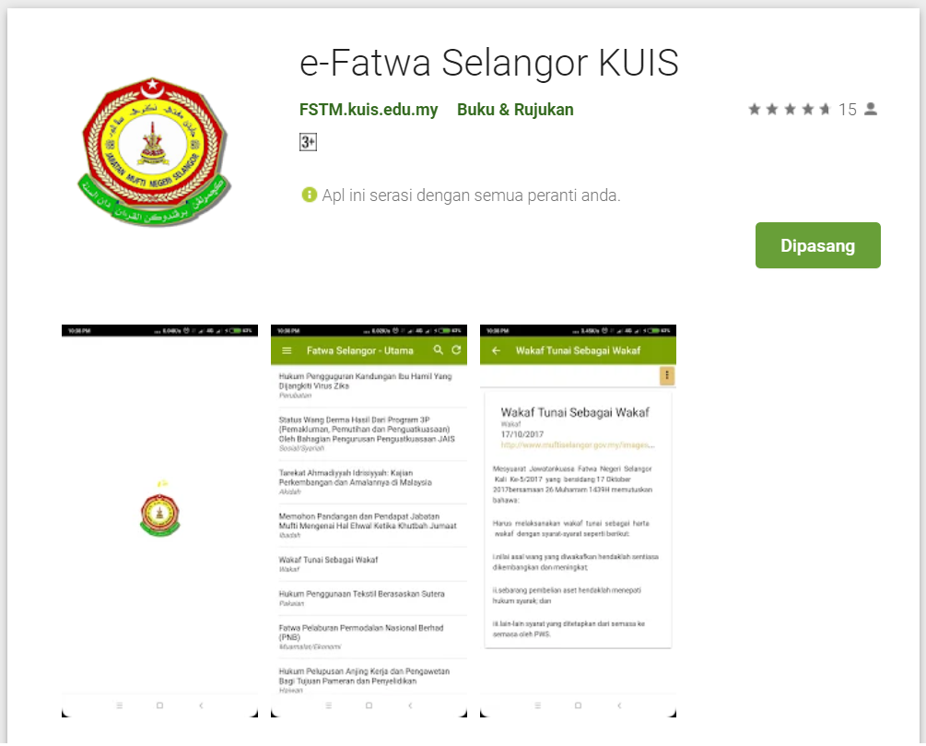
Available apps

Slide 9
IOS & Android Software Development
In a nutshell

Slide 10





Android Studio
(Java & Kotlin)
Android Device
NATIVE - 2 X WORK
XCode (Swift & Objective C)
iPhone/iPad

Slide 11

1 x WORK
Compile with Android SDK
Android Device
Cordova
Framework
Hybrid
XCode Project
iPhone/iPad

Slide 12
Cordova
Framework
Hybrid
WEB LAYER
NATIVE APP

Slide 13
1 x WORK
Build Progressive Web Apps
Android Device
Build Progressive Web Apps
Cordova
Framework
Hybrid
iPhone/iPad

Slide 14


1 x WORK
Android Studio
Android Device
+
XCode
iPhone/iPad

Slide 15
https://capacitor.ionicframework.com/

Slide 16



WHY IONIC?
Framework specifically to develop apps
Multiple platforms-Android, IOS, Windows, Amazon etc
Apps development using HTML & Typescript (subset of Javascript)
Plugins (camera, thumbprint, bluetooth, printer etc etc etc)

Slide 17
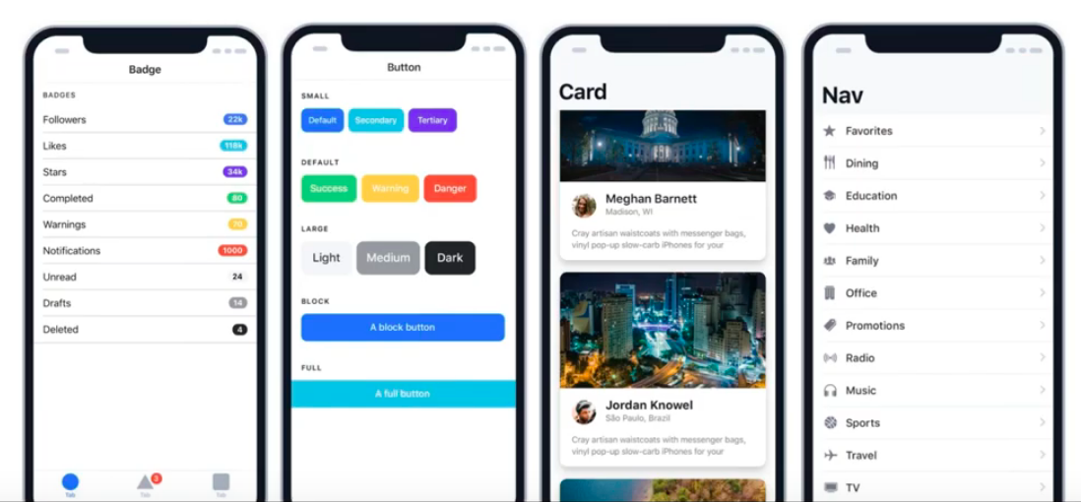
WHY IONIC?
Large COMMUNITY for support
Pre built gestures & animation
100+ UI Components
Everything is OPEN SOURCE
Built with Ionic

Slide 18
Software to start Ionic?

Slide 19
What do you need?
To run IONIC:
Node Package Manager (NPM)
Ionic Cordova Framework
Google Chrome Web Browser
To develop/publish app
VSCode OR any other IDE (with Typescript Plugin)
Ionic Capacitor
Android SDK or Xcode - can be done later

Slide 20
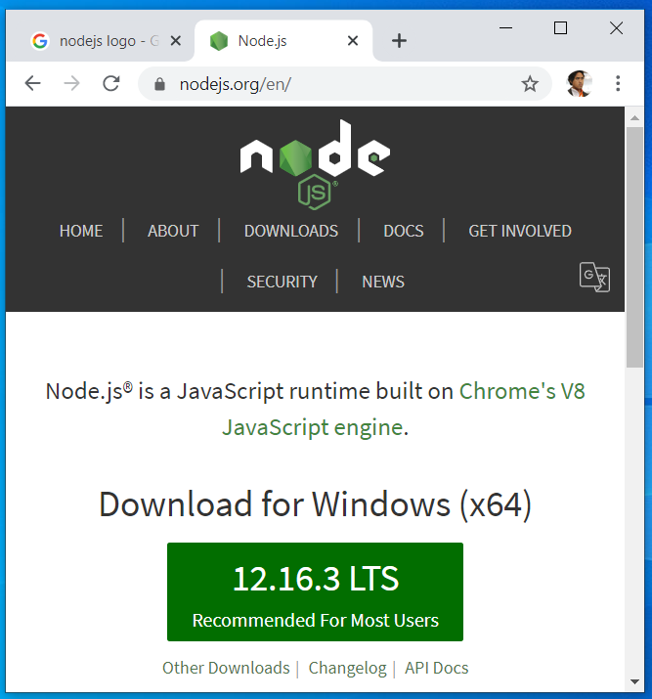

Download from nodejs.org
Download and install the LTS version
http://nodejs.org

Slide 21
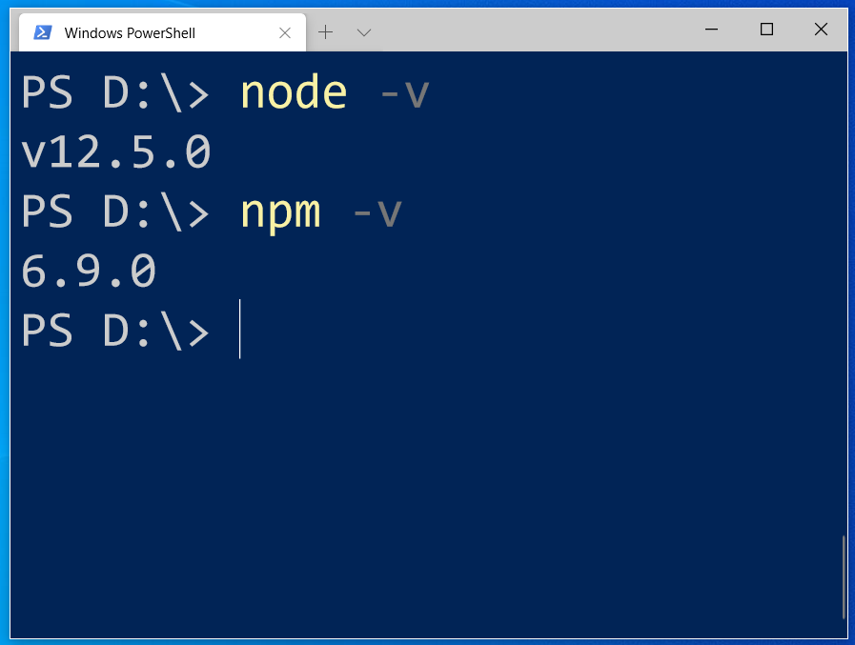
After install NodeJS from nodejs.org
node -v
npm -v

Slide 22
2. From command terminal run:
npm install -g ionic cordova

Slide 23
Now, let’s install the tools

Slide 24
Install VSCode/sublime
NodeJS
Tutorial is here bit.ly/ionickerul
Install Google Chrome Browser
(If you don’t have, you should)

Slide 25
Before we start coding, some basic stuff...

Slide 26
-HTML?
-CSS ?
-TypeScript ?

Slide 27
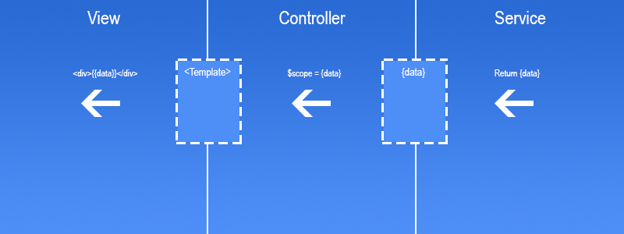
Simple MVC in Ionic
.HTML | .TS | services .TS /Model

Slide 28
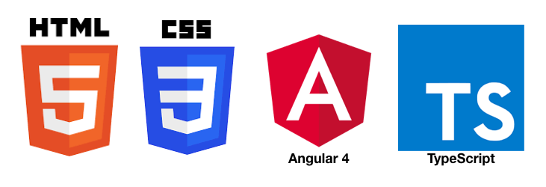
HTML
-Hyper Text Mark Up Language (HTML)
-Used to display the interface
-Write in tags,
-Example- <strong>Hello</strong> → Hello
-Ionic has its own built in tags
<ion-list></ion-list>
<ion-item></ion-item>
<ion-grid></ion-grid>
-HTML in Ionic is “AngularJS Flavoured”
-Have to use Angular Syntax for data and clicks
-Example- (click), *ngFor etc

Slide 29
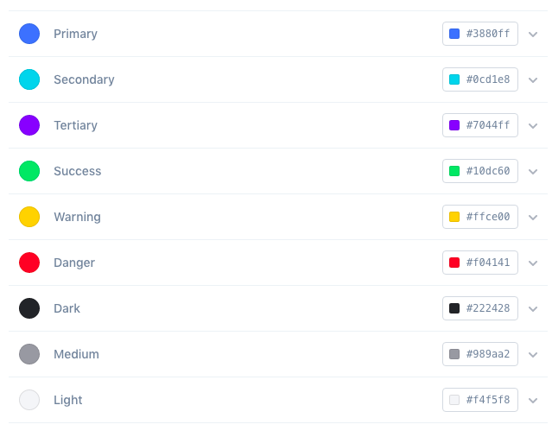
CSS or SCSS
-Cascading Style Sheets (CSS)
-Used for styling, very straightforward
-Each generated Ionic page comes with built in own CSS
-Can assist in ‘theming’ the app
-Ionic has standard built in colours
-Primary, Secondary, Danger, Light & Dark
Built in colours that can be added/edited

Slide 30
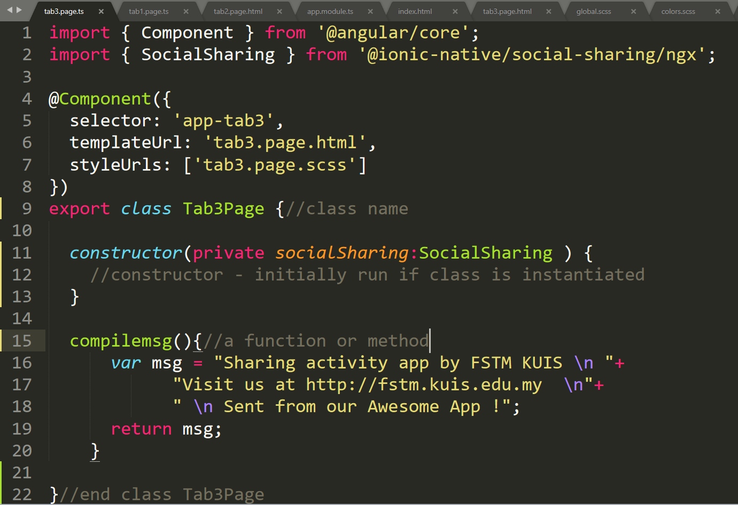
Class Function

Slide 31
Hello World ionic

Slide 32
1. Start a project
ionic start appfstm tabs

Slide 33
2. CD into Directory & Run the project
ionic serve

Slide 34
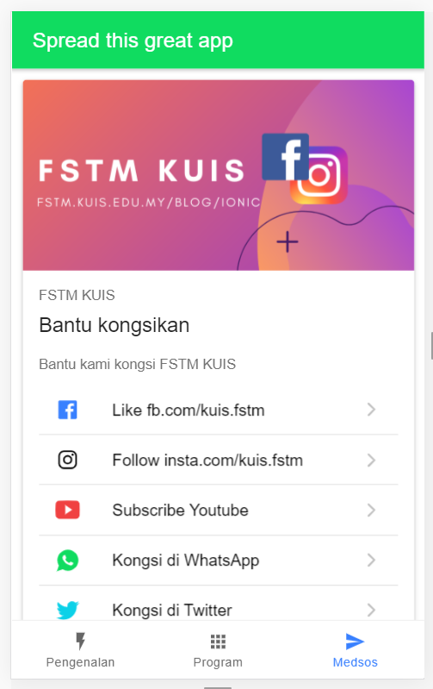
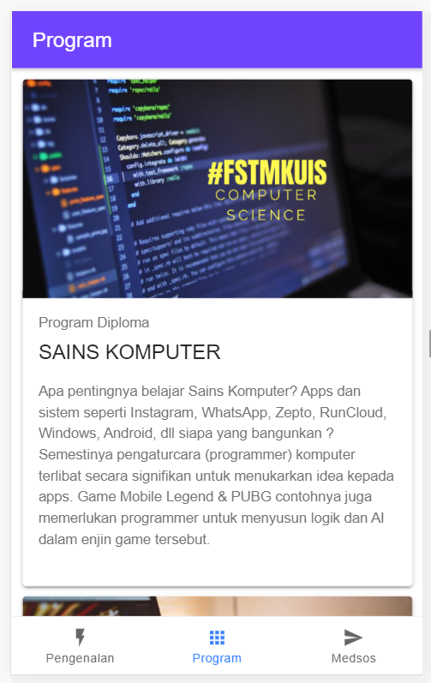
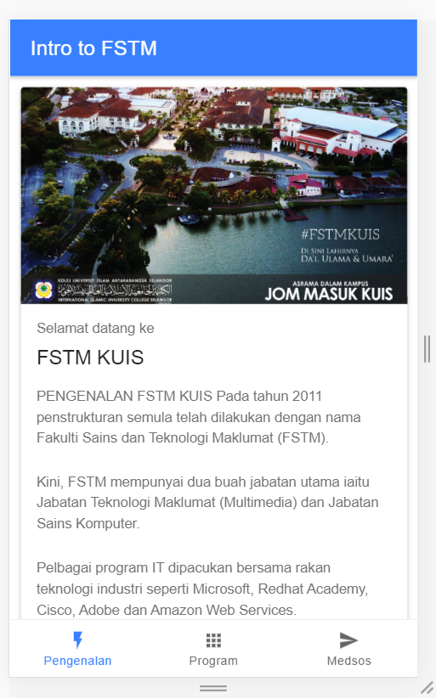
Next tab2 and tab3

Slide 35


T02 HTML interface
(antaramuka)

Slide 36
1. Start a project
ionic start appfstm tabs

Slide 37
2. CD into Directory & Run the project
ionic serve

Slide 38
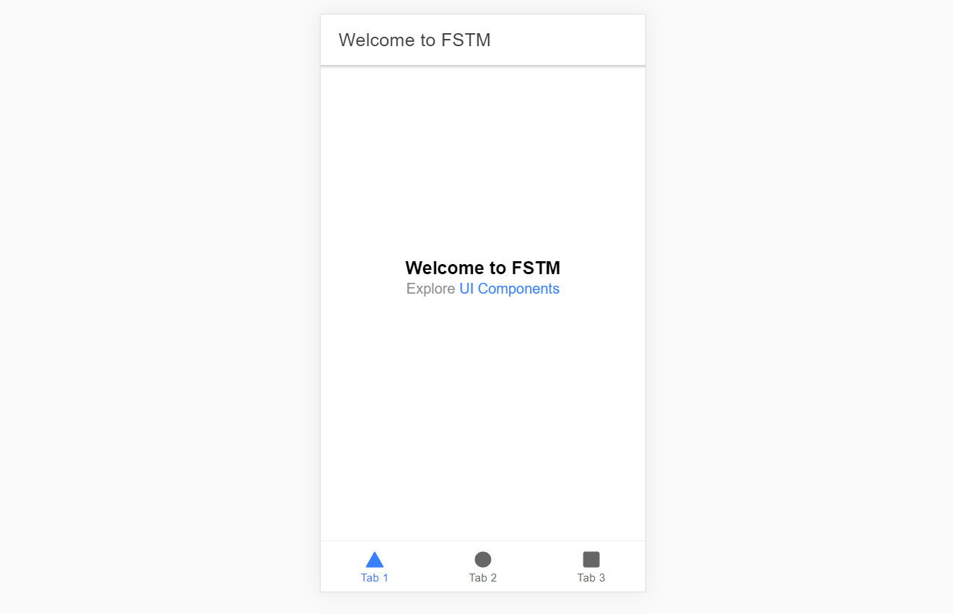
Output : ionic serve

Slide 39
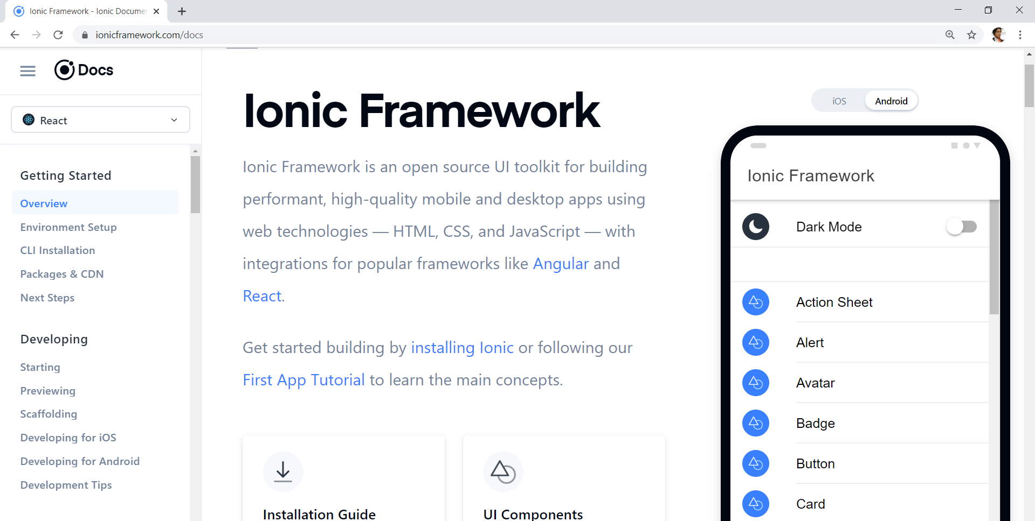
Always refer to documentations: https://ionicframework.com/docs

Slide 40
HTML
-Hyper Text Mark Up Language (HTML)
-Used to display the interface
-Write in tags,
-Example- <strong>Hello</strong> → Hello
-Ionic has its own built in tags
<ion-list></ion-list>
<ion-item></ion-item>
<ion-grid></ion-grid>
-HTML in Ionic is “AngularJS Flavoured”
-Have to use Angular Syntax for data and clicks
-Example- (click), *ngFor etc

Slide 41
CSS or SCSS
-Cascading Style Sheets (CSS)
-Used for styling, very straightforward
-Each generated Ionic page comes with built in own CSS
-Can assist in ‘theming’ the app
-Ionic has standard built in colours
-Primary, Secondary, Danger, Light & Dark
Built in colours that can be added/edited

Slide 42
Next tab2 and tab3

Slide 43
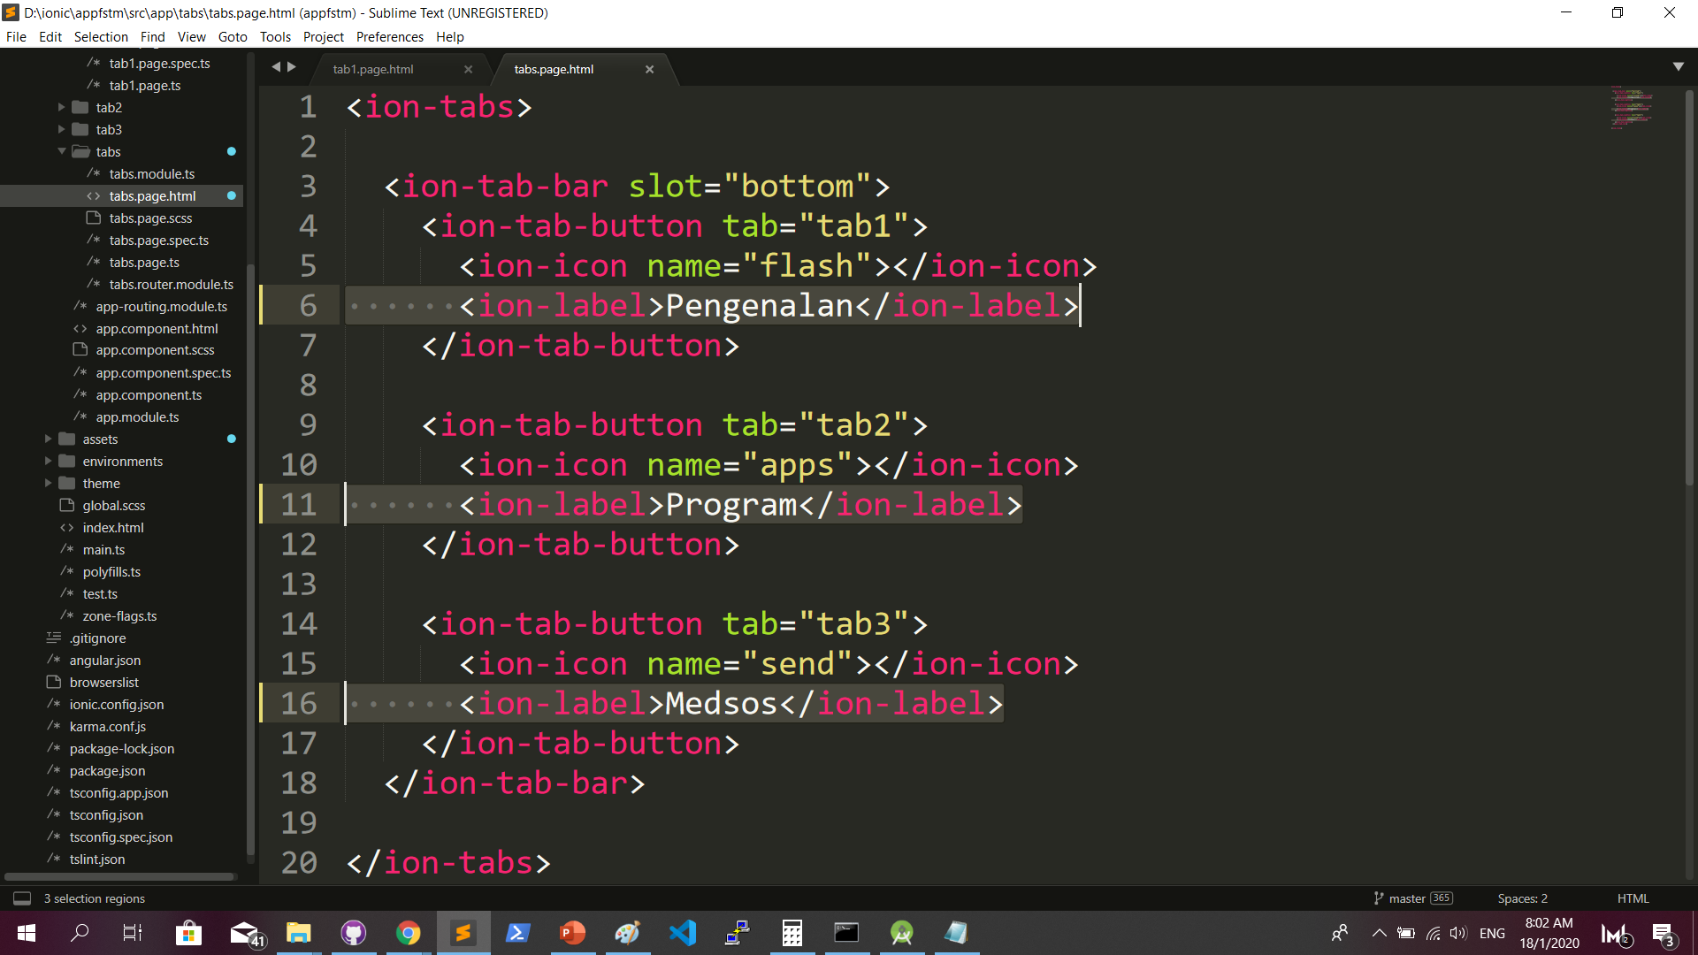
Some interface cosmetics: src/app/tabs/tabs.page.html

Slide 44
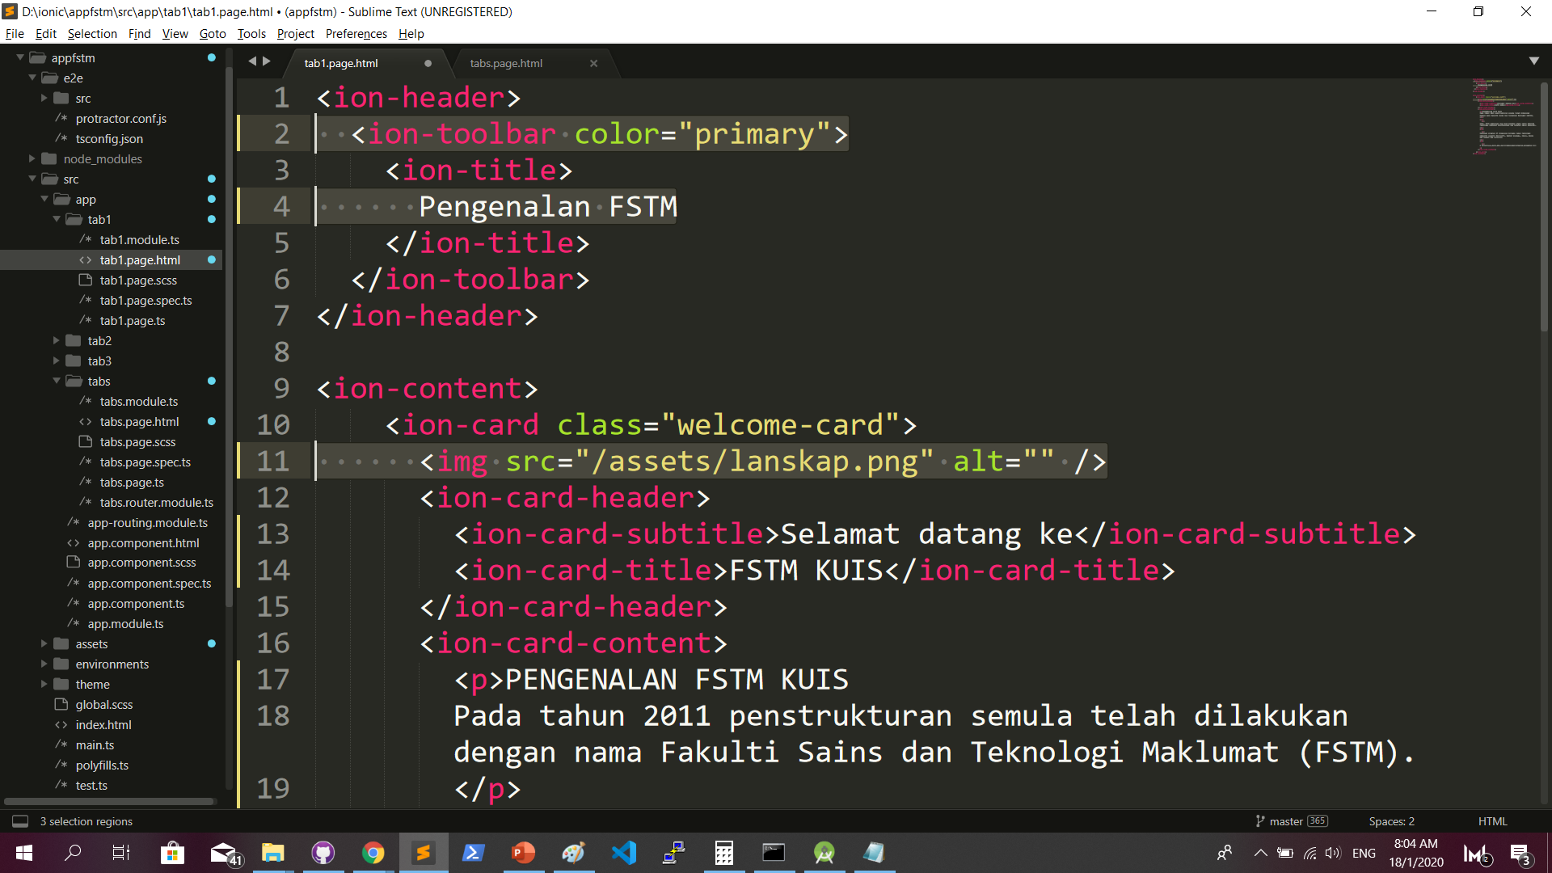
More interface cosmetics: src/app/tab1/tab1.page.html

Slide 45
Run ionic serve

Slide 46
Next tab2 and tab3

Slide 47
Codes & slides github.com/khirulnizam/ionic5

Slide 48
T03 Navigasi
(page navigation)

Slide 49
Page Navigation
+ routerLink (in .html) + NavController (in .ts)

Slide 50
routerLink in HTML
PAGE 1
PAGE 2
See app-routing.module.ts for page name

Slide 51
Exercise : Link to new page
Generate new pages
ionic g page info
ionic g page form

Slide 52
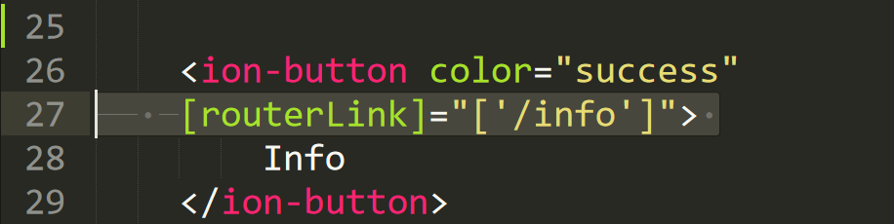
Exercise : Link to new page

Slide 53
NavController in TS
PAGE 1
PAGE 2
See app-routing.module.ts for page name

Slide 54
Add simple form interaction
+ Form Button + Alert function

Slide 55
Try building a button and make an alert
helloWorld(){
alert(“Hello Ionic!”)
}
<ion-button (click)=”helloWorld()”> ALERT </ion-button>
info.page.ts
info.page.html

Slide 56
Codes & slides github.com/khirulnizam/ionic5

Slide 57

T04 TypeScript

Slide 58
TypeScript
-A subset of Javascript
-Part of ECMA6 standard
-The ‘brains’ behind your app
-Used for processing & handling data
Example- calculation, accessing DB etc
-Ionic has standard built in to its TS:
NavController, ModalController etc

Slide 59
Typescript Syntax : Function
let n1:number;
let n2:number;
output:number;
addnumbers(){
output=n1+n2;
displayresult( );
}
displayresult( ){
alert(“Output: ”+output);
}

Slide 60
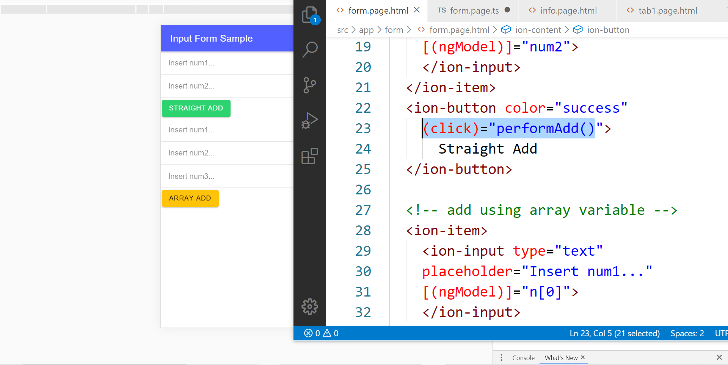
In file .HTML

Slide 61
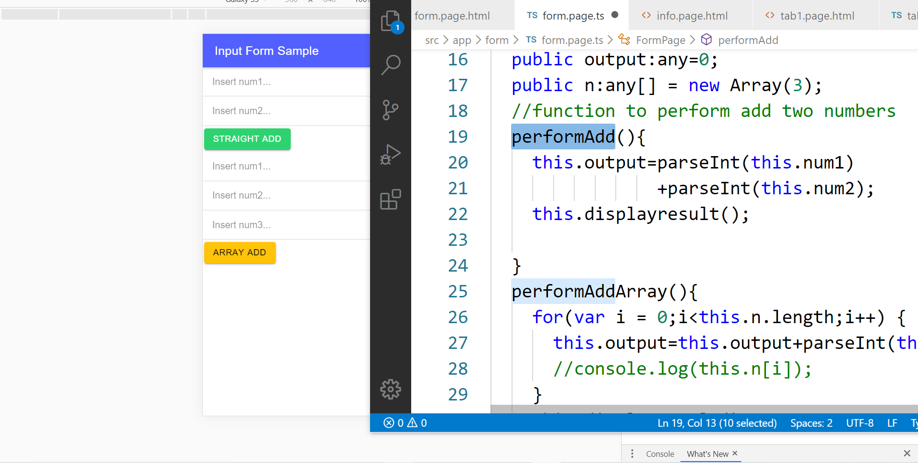
In file .TS

Slide 62
TypeScript Syntax : EX1 variable
What is a variable?
A variable acts as a container for values in a programming code.
var pi:number = 3.14;
Var num1:number=5;
var name:string =“enKerul”;
Use any to loosely-type the variable data type.
Data types:
any
can be numbers or strings
string
“this is string ” + “ concat ”
number
Double 3.14, or integer 5
array
can be a collection of Var, Strings or Objects

Slide 63
Typescript Syntax : EX2 String manipulation & Casting
//to convert String to number
var str = "54";
//easy way by using + operator
var num = +str; var num = parseInt(str);
String manipulation?
var str:string = "3.14";
var pi:number = 3.14;
console.log("pi is "+pi);
console.log("tau is "+(2 * pi));

Slide 64
Typescript Syntax : EX3 Array
Array? Array
can be a collection of Var, Strings or Objects
// A list literal.
var numbers = [4, 1, 5, 6, 3, 2];
for(var i=0;i<numbers.length; i++)
{
sum=sum+numbers[i]);
console.log(“Sum: ”+sum);
}
-----
Output
Sum: 21

Slide 65
Typescript Syntax : EX4 Associative array
Associative Array?
Array with key and value pairs (not index number).
// A map literal.
// Asociative array
var gases = [
'He': 'Helium',
'Ne': 'Neon',
'Ar': 'Argon’,
];
console.log(gases['Ne’]);
-------------------------
Output: Neon

Slide 66


T05 Kamera (installing camera plug-ins)

Slide 67
Codes & slides github.com/khirulnizam/ionic5

Slide 68
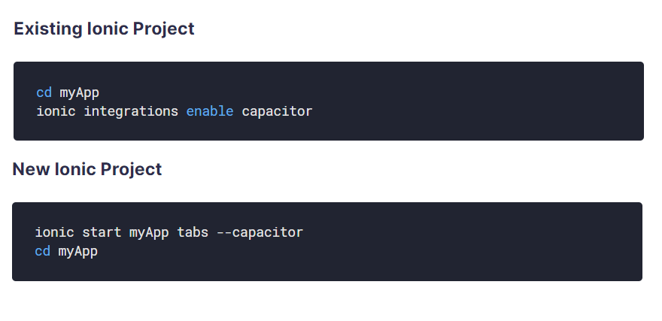
Using Capacitor with Ionic

Slide 69
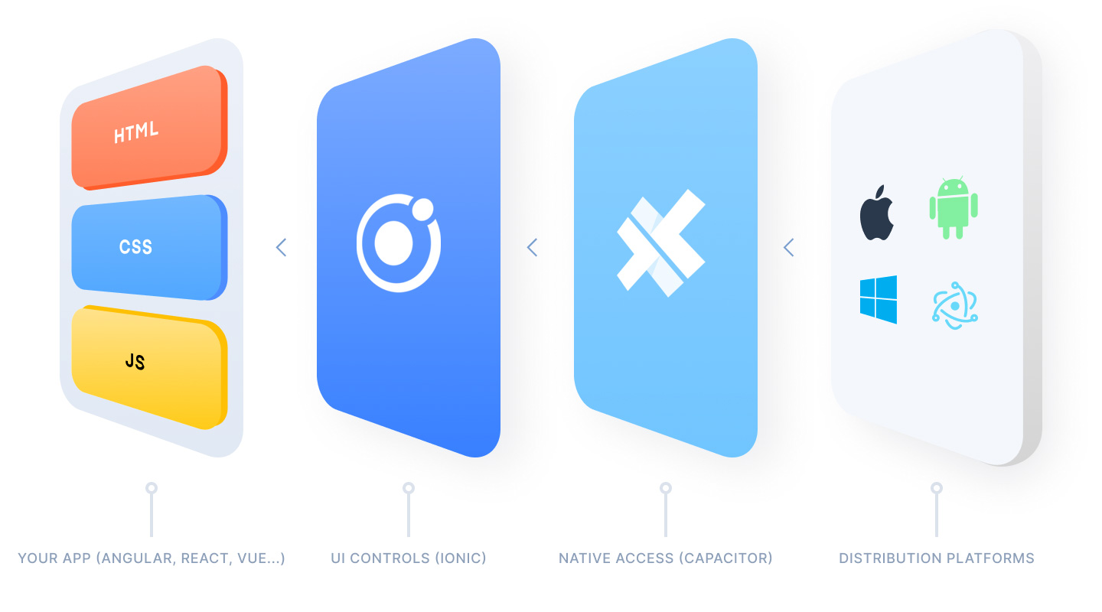
Ionic Capacitor
https://ionicframework.com/resources/articles/capacitor-vs-cordova-modern-hybrid-app-development
runs modern Web Apps natively on iOS, Android, Electron, and Web

Slide 70
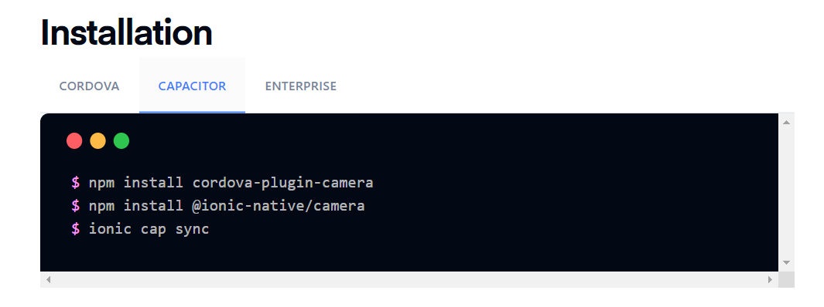
Install camera support : ionicframework.com/docs/native/camera

Slide 71
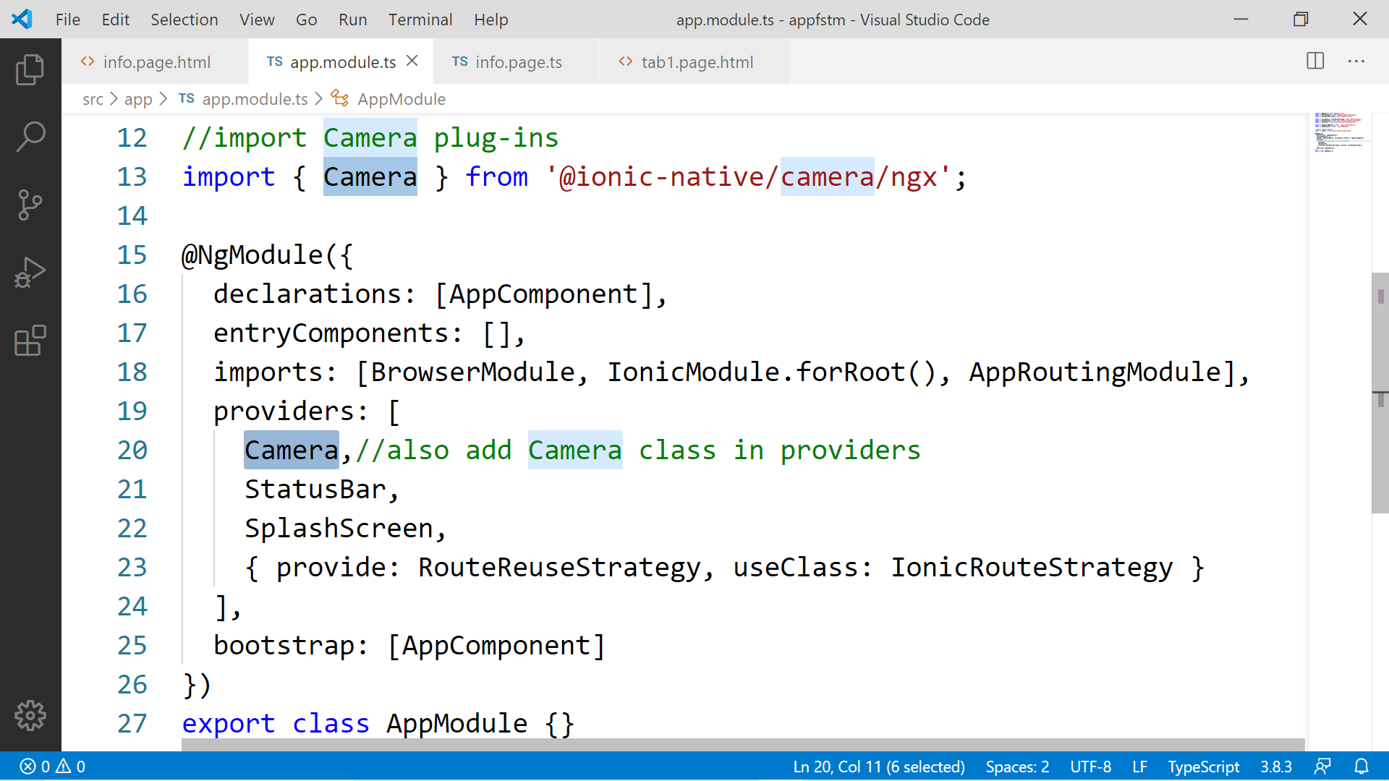

Slide 72
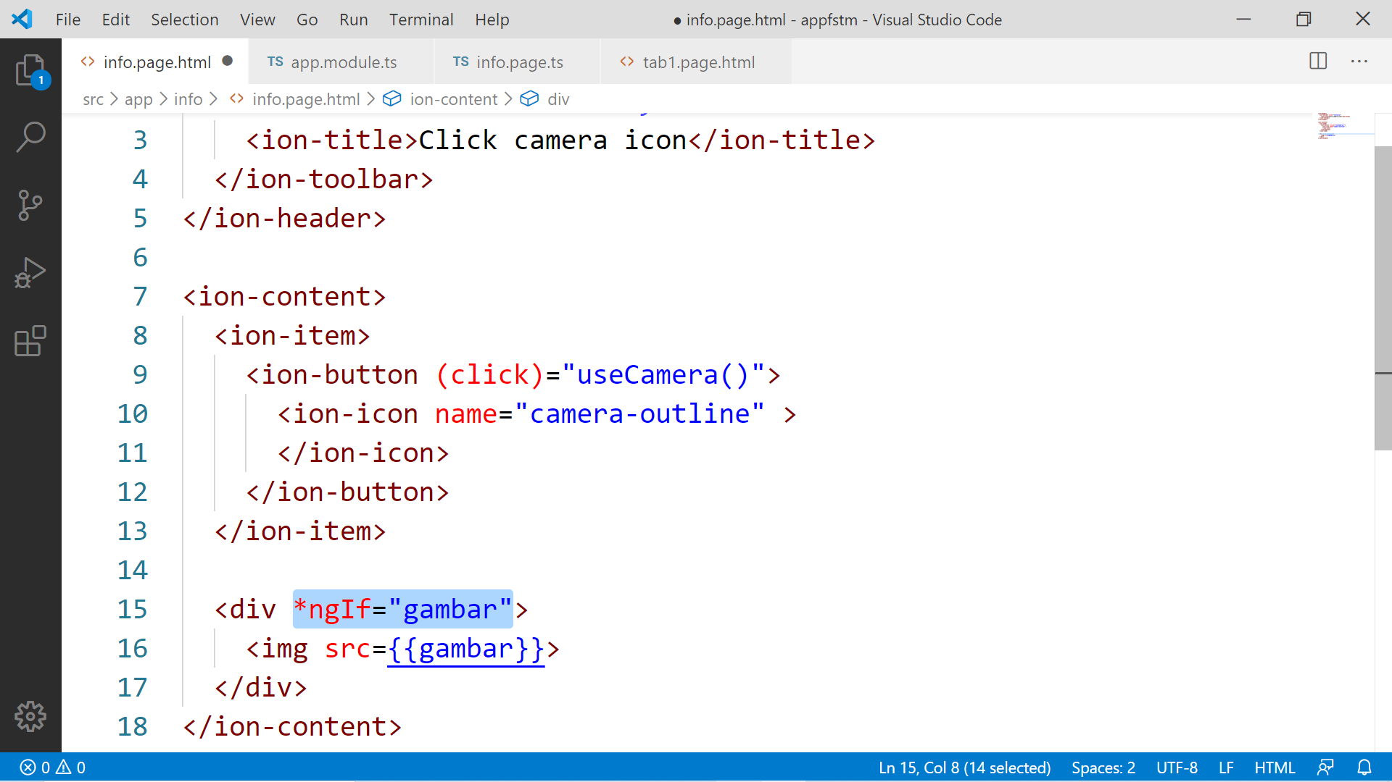

Slide 73
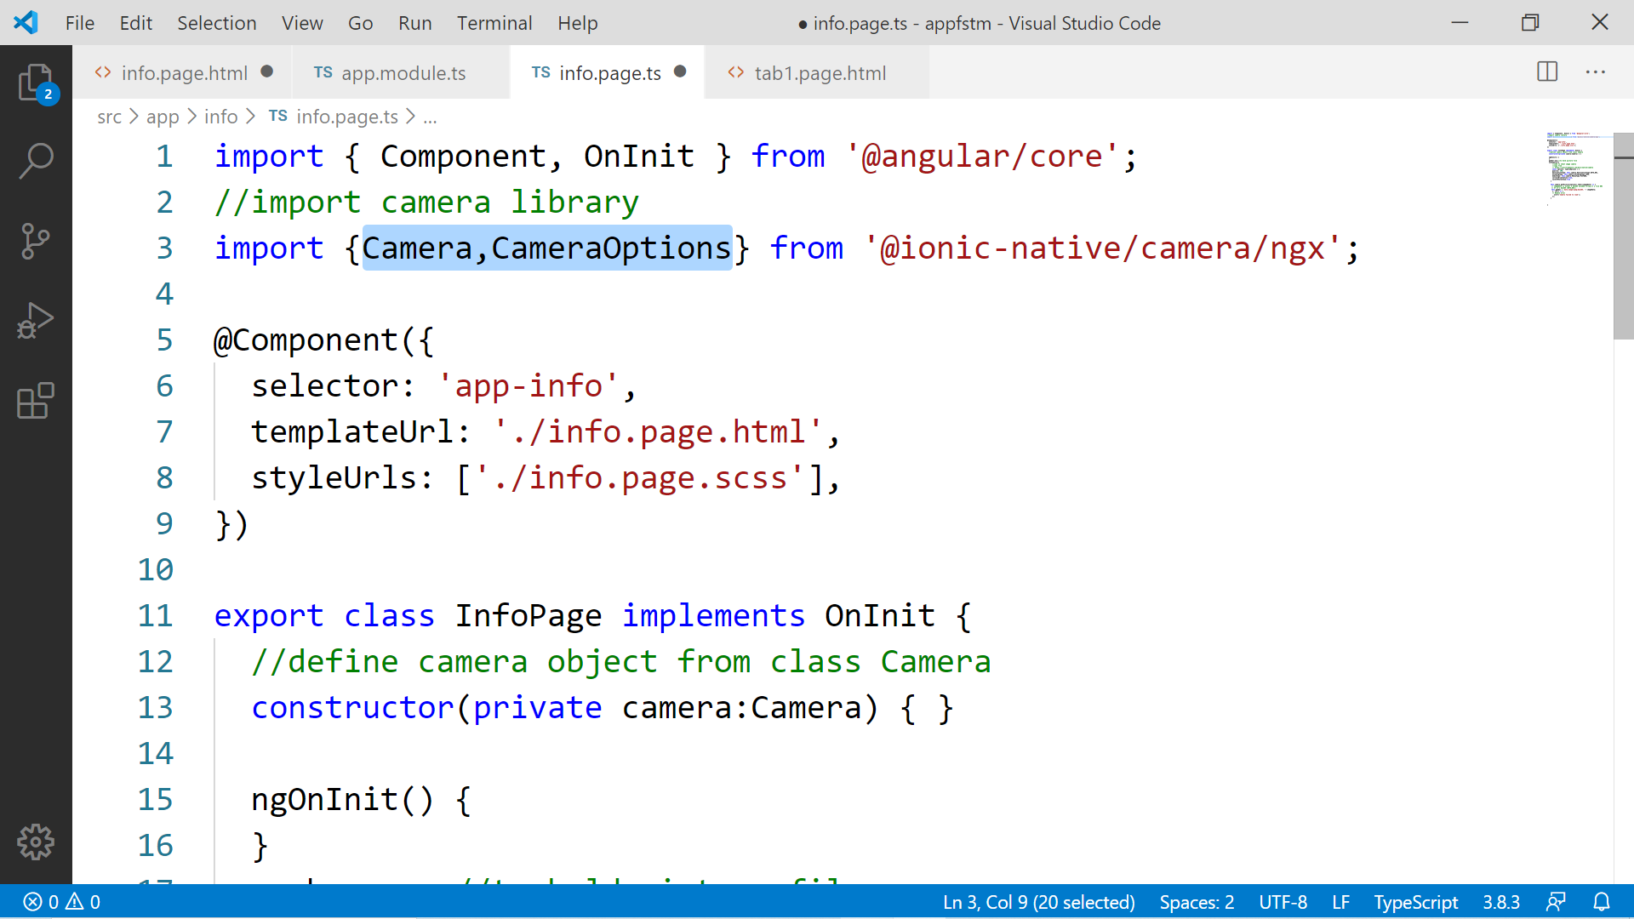

Slide 74
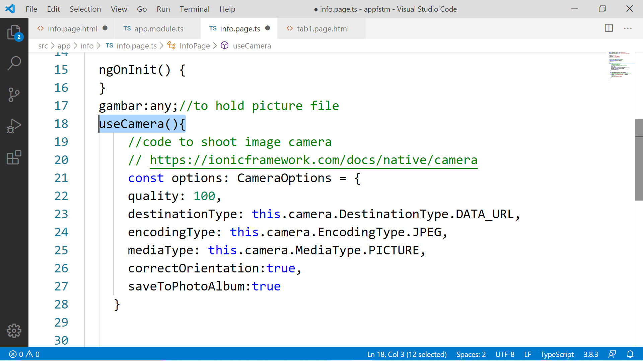

Slide 75
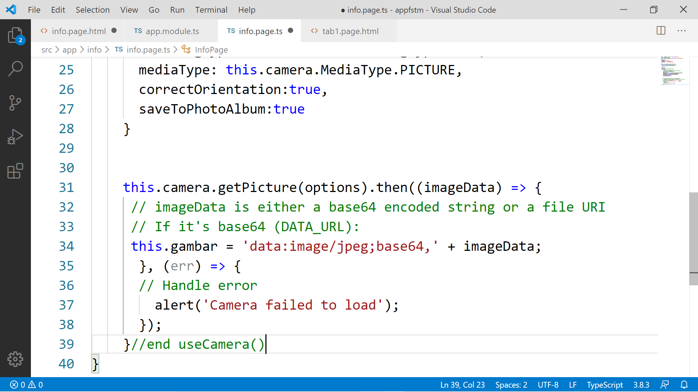

Slide 76
Migration Cordova to Capacitor - error: package android.support.v4.content does not exist
npm install jetifier
npx jetifier
npx cap sync android

Slide 77
Ionic Capacitor
https://ionicframework.com/resources/articles/capacitor-vs-cordova-modern-hybrid-app-development
runs modern Web Apps natively on iOS, Android, Electron, and Web

Slide 78
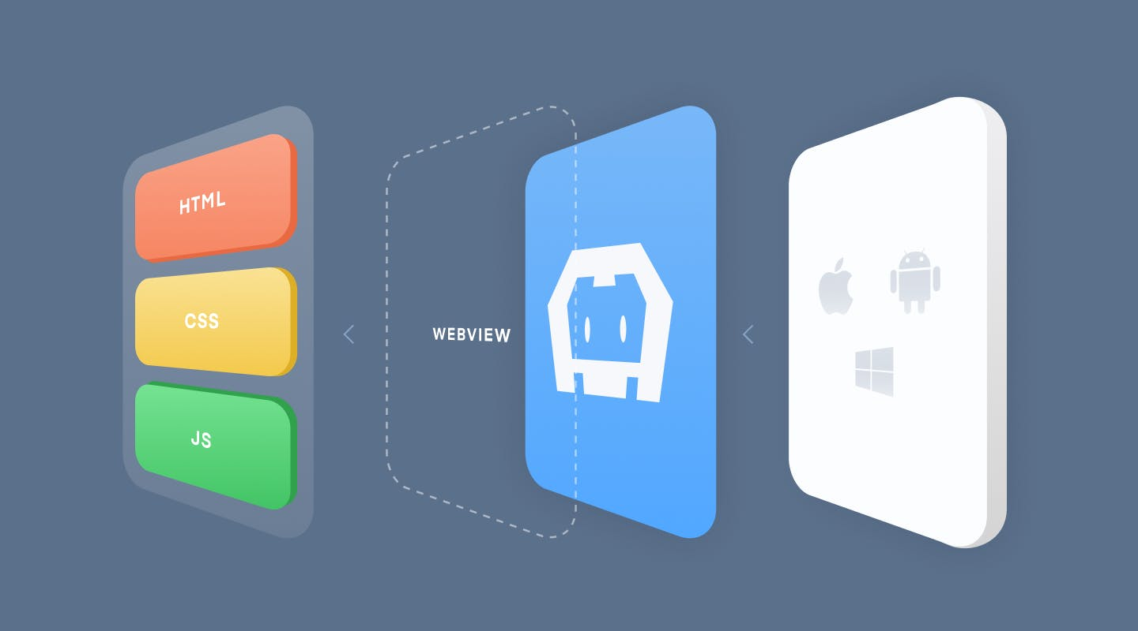
Previously we have CORDOVA

Slide 79
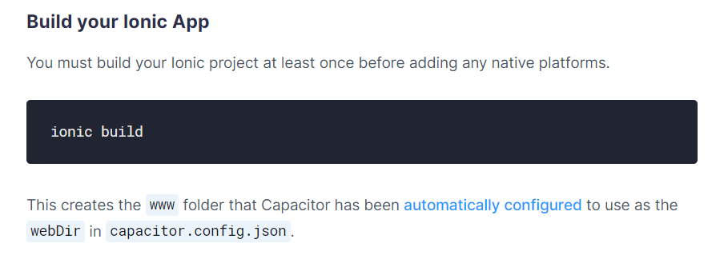
Ionic build

Slide 80
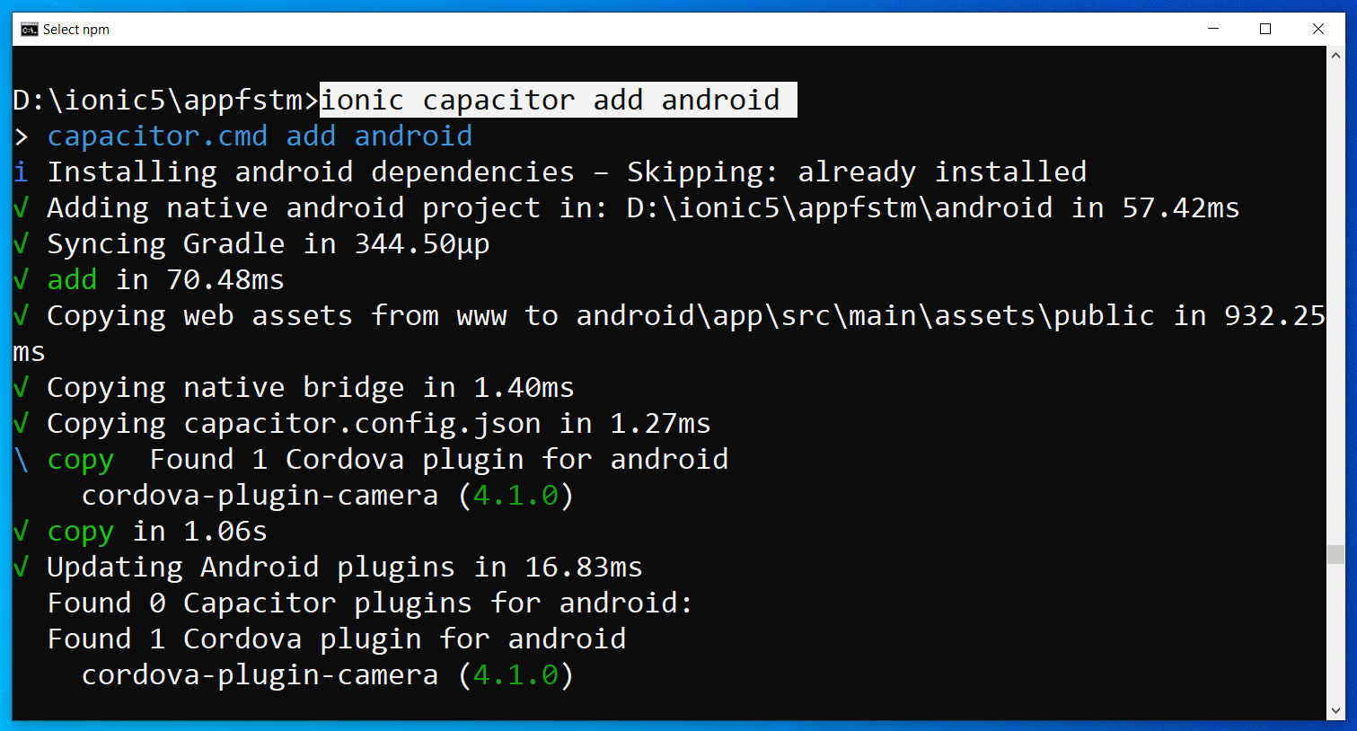
Run only once for each ionic project
To update Android project, execute
ionic build
npx cap copy

Slide 81
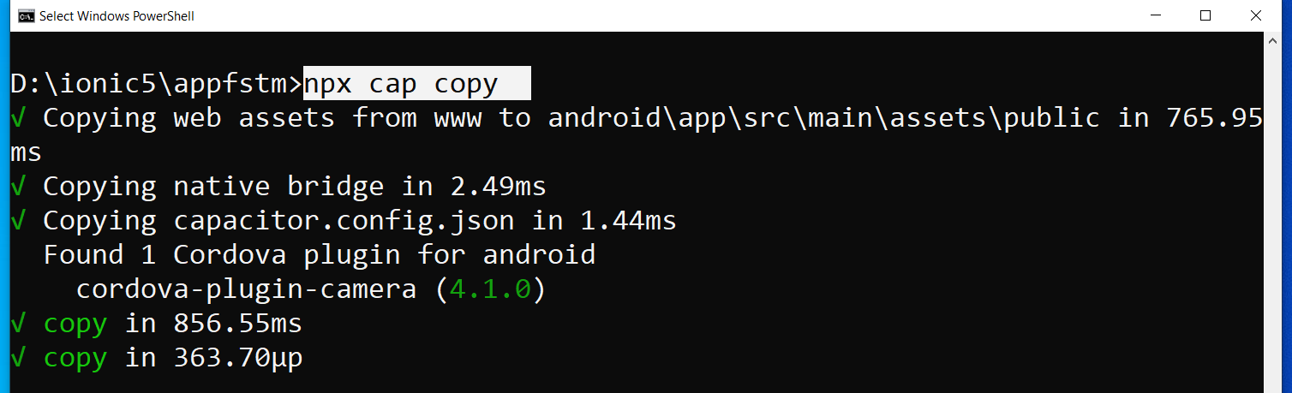
After finish installing the camera plug-ins

Slide 82
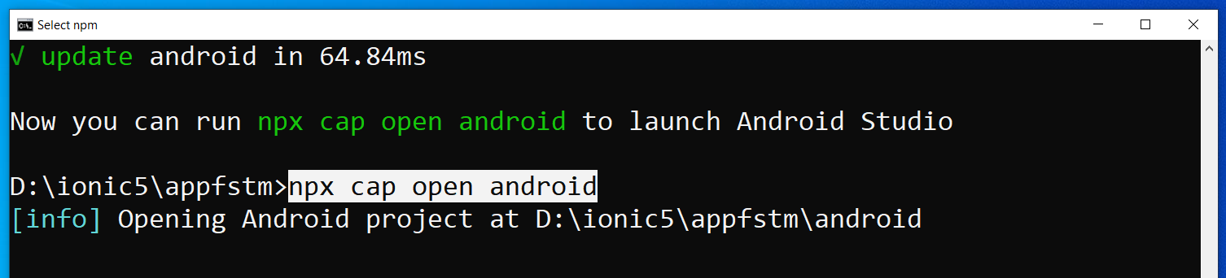
To open project on Android Studio

Slide 83
Codes & slides github.com/khirulnizam/ionic5

Slide 84
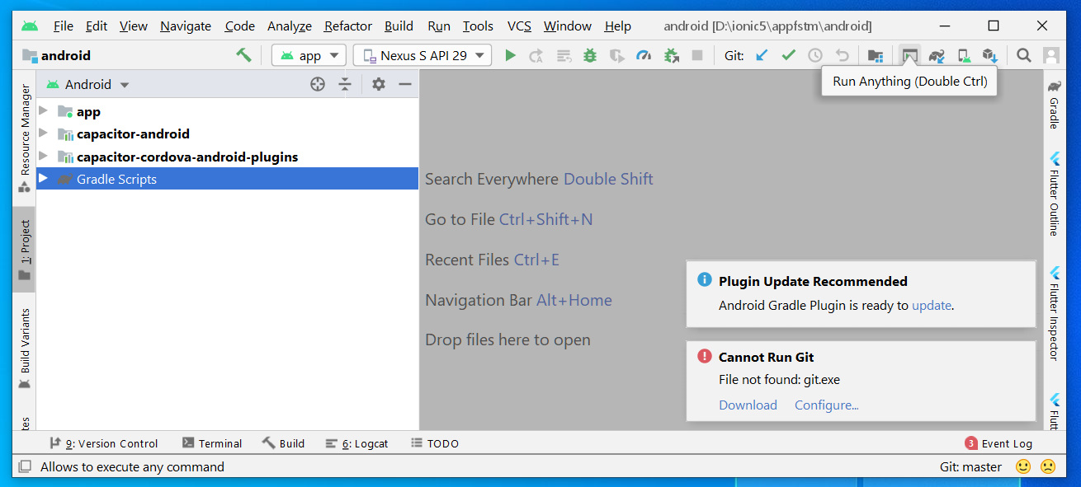
Open in Android Studio

Slide 85
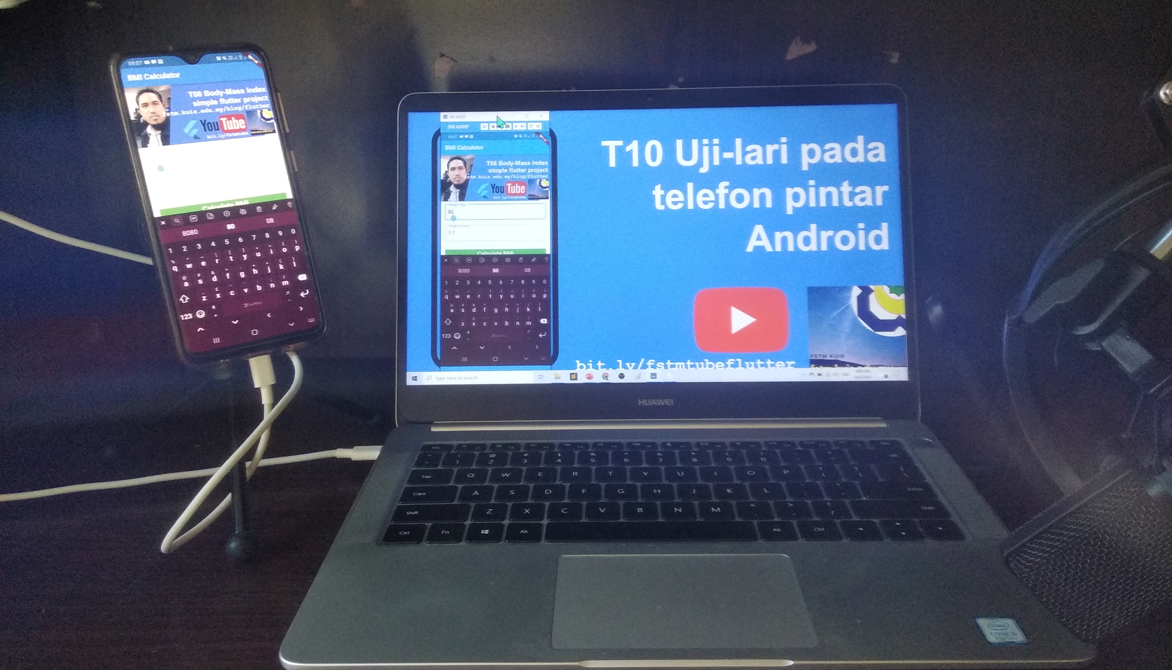

T06 Uji-lari (run app on Android)

Slide 86

Android Studio 3.6 & SDK developer.android.com/studio

Slide 87
Path settings (environment variables)
ANDROID_SDK_ROOT
JAVA_HOME

Slide 88
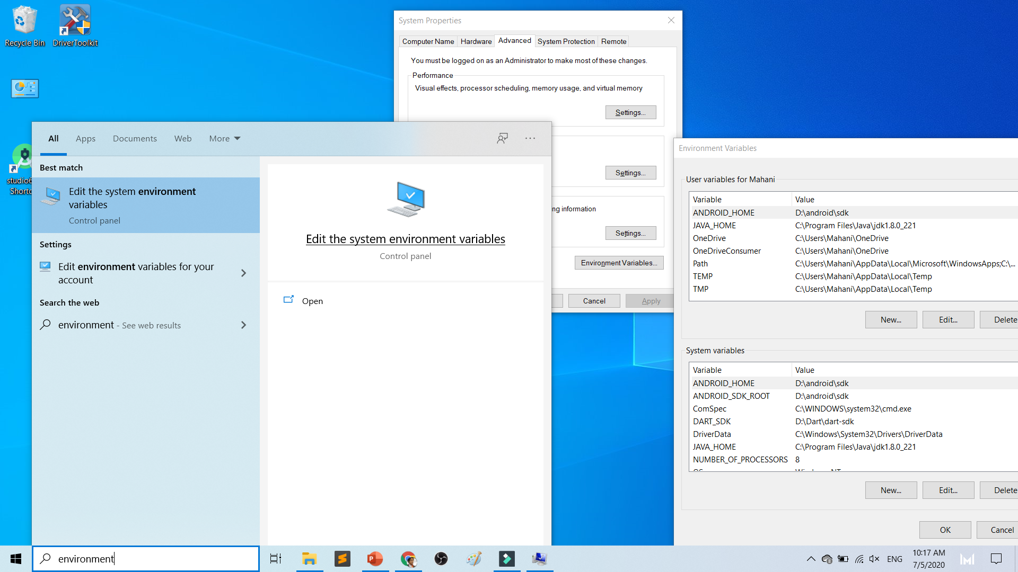

Slide 89
To deploy
Android Studio
Android SDK
Android Phone with USB Debugging enabled
ADB Bridge
USB Data-cable for Actual Device

Slide 90
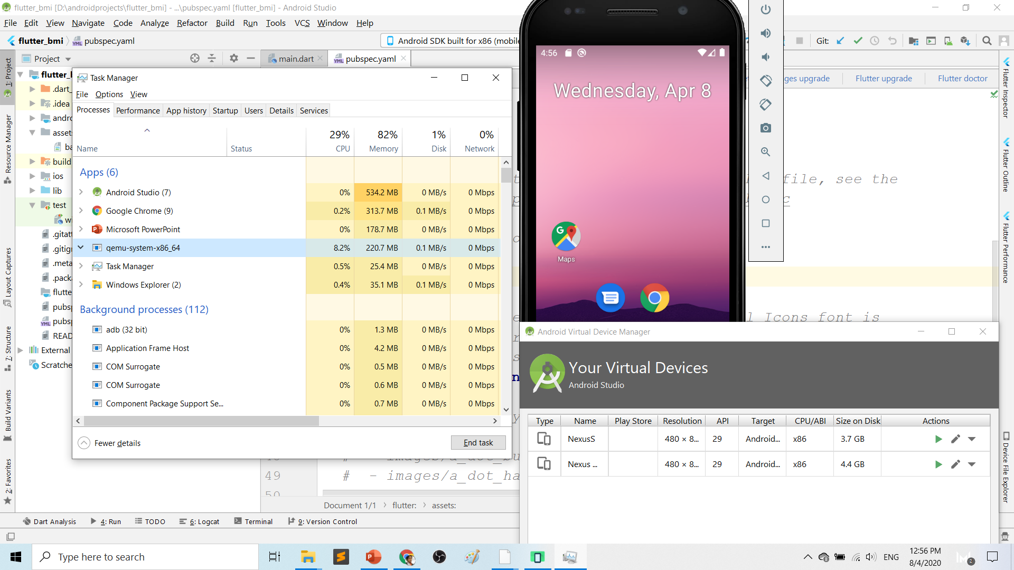
Play.google.com
What’s wrong with Android Studio & Emulator? RESOURCE-HUNGER

Slide 91
Requirements 1. USB debugging ON- phone 2. Connect USB Cable 3. Install ADB driver in PC

Slide 92
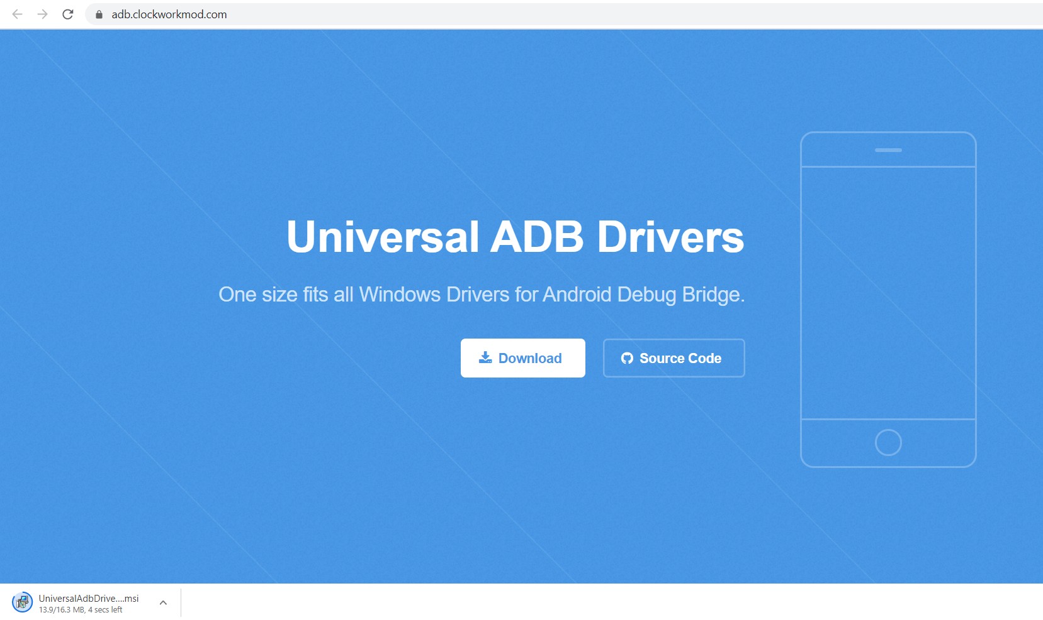
Play.google.com
Install universal debug driver
https://adb.clockworkmod.com/
Download & install universal debug

Slide 93
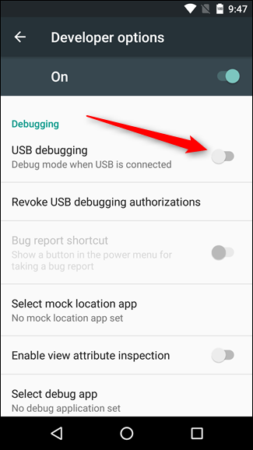
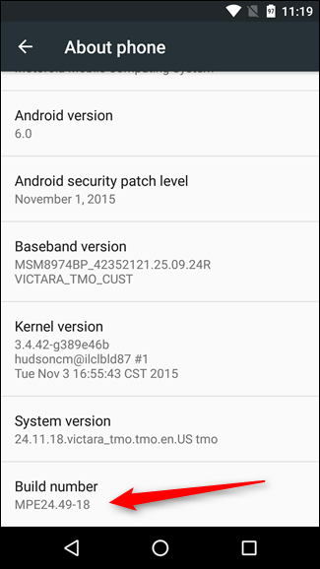
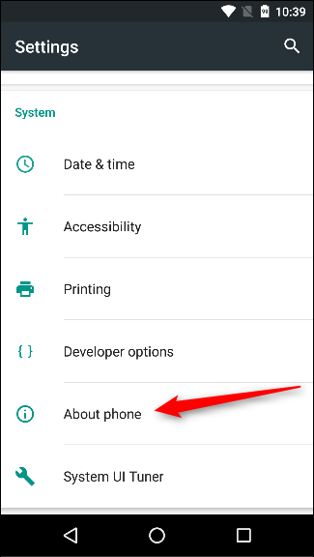
First time to on USB Debugging?
Developer options enable
Press 7X on build number
press 7x

Slide 94
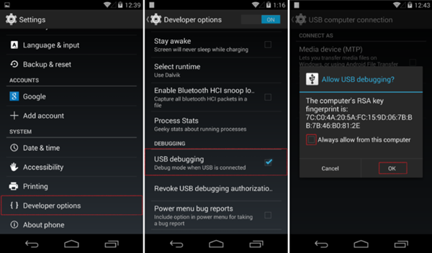
First time Allow USB debugging?

Slide 95
Ionic build

Slide 96
Create Android project/platform ionic capacitor add android
Run only once for each ionic project
To update Android project, execute
ionic build
npx cap copy

Slide 97
Copy to www to android project npx cap copy

Slide 98
To open project on Android Studio npx cap open android

Slide 99
Open in Android Studio

Slide 100
Codes & slides github.com/khirulnizam/ionic5

Slide 101


T07 Pilihan Selection : if…else, ngIf

Slide 102
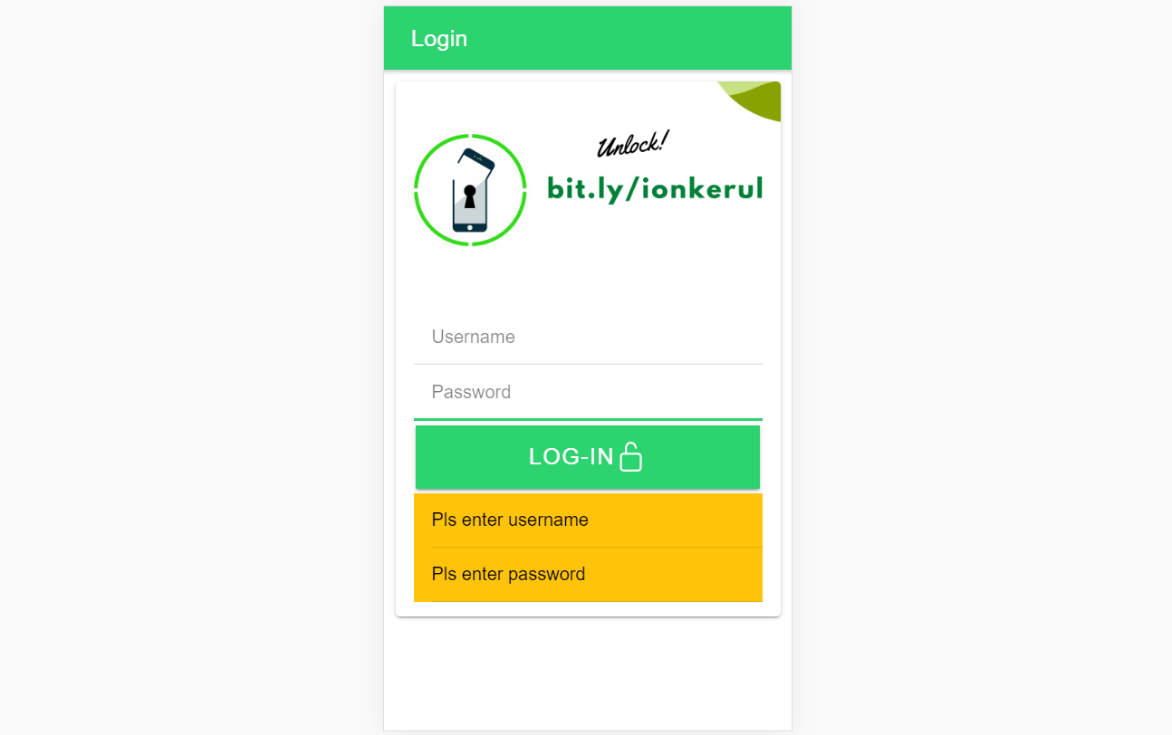
Output overview

Slide 103
Create a new page
ionic g page login
(selection exercise)

Slide 104
[(ngModel)]
Example:
IN TYPESCRIPT:
username:any;
password:any;
IN HTML:
<ion-input [(ngModel)]= “username”>
</ion-input>
<ion-input [(ngModel)]= “password”>
</ion-input>
[(ngModel)] USED IN HTML to capture what is typed into input to TypeScript

Slide 105
*ngIf used in HTML
Usually used for array iterations
Example:
IN HTML
<div *ngIf= “ username==null ”>
Pls enter username
</div>
<div *ngIf= “ password==null ”>
Pls enter password
</div>
*ngIf USED IN HTML

Slide 106
*ngIf … else used in HTML
<div *ngIf="gambar; else noImageYet">
<img src="{{gambar}}">
</div>
<ng-template #noImageYet>
<img src="./assets/noimagep.png">
</ng-template>
*ngIf … else USED IN HTML

Slide 107
IF...ELSE IF...ELSE AND *ngIFStatements
Usually used for selection and/or filtering
Example:
if(username== null){
alert(“Pls insert username”);
}
else if(password==null){
alert(“Pls insert password”);
}
else {
alert(“Welcome user”);
}
IF...ELSE IF..ELSE USED IN TYPESCRIPT IS EXACTLY THE SAME AS JAVASCRIPT

Slide 108
Output

Slide 109

T08 Ulangan Repetition : for, foreach, ngFor

Slide 110
Codes & slides github.com/khirulnizam/ionic5

Slide 111
Create a new page
ionic g page irepeat
(repetition exercise)

Slide 112
For Loop and *ngFor
Usually used for array iterations. Example:
negeri[0]= “Johor”;
negeri[1]= “Melaka”;
negeri[2]= “N. Sembilan”;
negeri[3]= “Selangor”;
for(var x=0;x<negeri.length;x++)
{
console.log(negeri[x]);
}
This will output in the console all the items in the array
FOR LOOP USED IN TYPESCRIPT

Slide 113
For Loop and *ngFor
Usually used for array iterations
Example:
IN TYPESCRIPT
negeri[0]= “Johor”;
negeri[1]= “Melaka”;
negeri[2]= “N. Sembilan”;
negeri[3]= “Selangor”;
IN HTML
<ion-item *ngFor= “let item of negeri”>
{{ item }}
</ion-item>
This will output all the negeris in HTML
*ngFor LOOP used in HTML

Slide 114

T09 Navigasi (navigation with parameters)

Slide 115
PARAMETERS
PAGE 1
(irepeat)
PAGE 2
(displayparams)
Nama: Kerul
Poskod: 43000
Negeri: Selangor
Nama: Kerul
Poskod: 43000
Negeri: Selangor
Nama: Kerul
Poskod: 43000
Negeri: Selangor

Slide 116
Navigation with Parameters
1. Using Router
TO SEND VALUES (CANNOT SEND OBJECTS)

Slide 117
2. Using Services
Navigation with Parameters
*TO SEND OBJECTS

Slide 118
Using ActivatedRoute
On app-routing.module.ts add param name, example /:id
Add /id when navigating
To get param
import {Router} from ‘@angular/router’
public route:Router
let the_id=this.route.snapshot.params.id

Slide 119
Using Services

Slide 120
USING SERVICES
HOME
SERVICES:
Functions
createUser(email, password)
{
…
}
loginUser(){
…
}
listUsers(){
…
}
DAFTAR
LOGIN
OTHER SERVICES

Slide 121
Using SERVICES
Services can be used globally
Can be used repeatedly
By different pages/other services

Slide 122
Generate a service
ionic g service service/data
Import Service and call from page ts

Slide 123


Slide 125


shareMasjid

Slide 126

& Firestore Auth

Slide 127


t10 Firebase (setup)

Slide 128

github.com/khirulnizam/ionic5 wasap.my/60129034614

Slide 129

Serverless option using Firebase
Serverless computing is a method of providing backend services on an as-used basis
A Serverless provider allows users to write and deploy code without the hassle of worrying about the underlying infrastructure
Scalable - the serverless vendor handles all of the scaling on demand
Simplified backend code
Quicker turnaround

Slide 130

JSON Concept
JSON: JavaScript Object Notation.
JSON is a lightweight data-interchange format
JSON format is text only, it can easily be sent to and from a server.

Slide 131
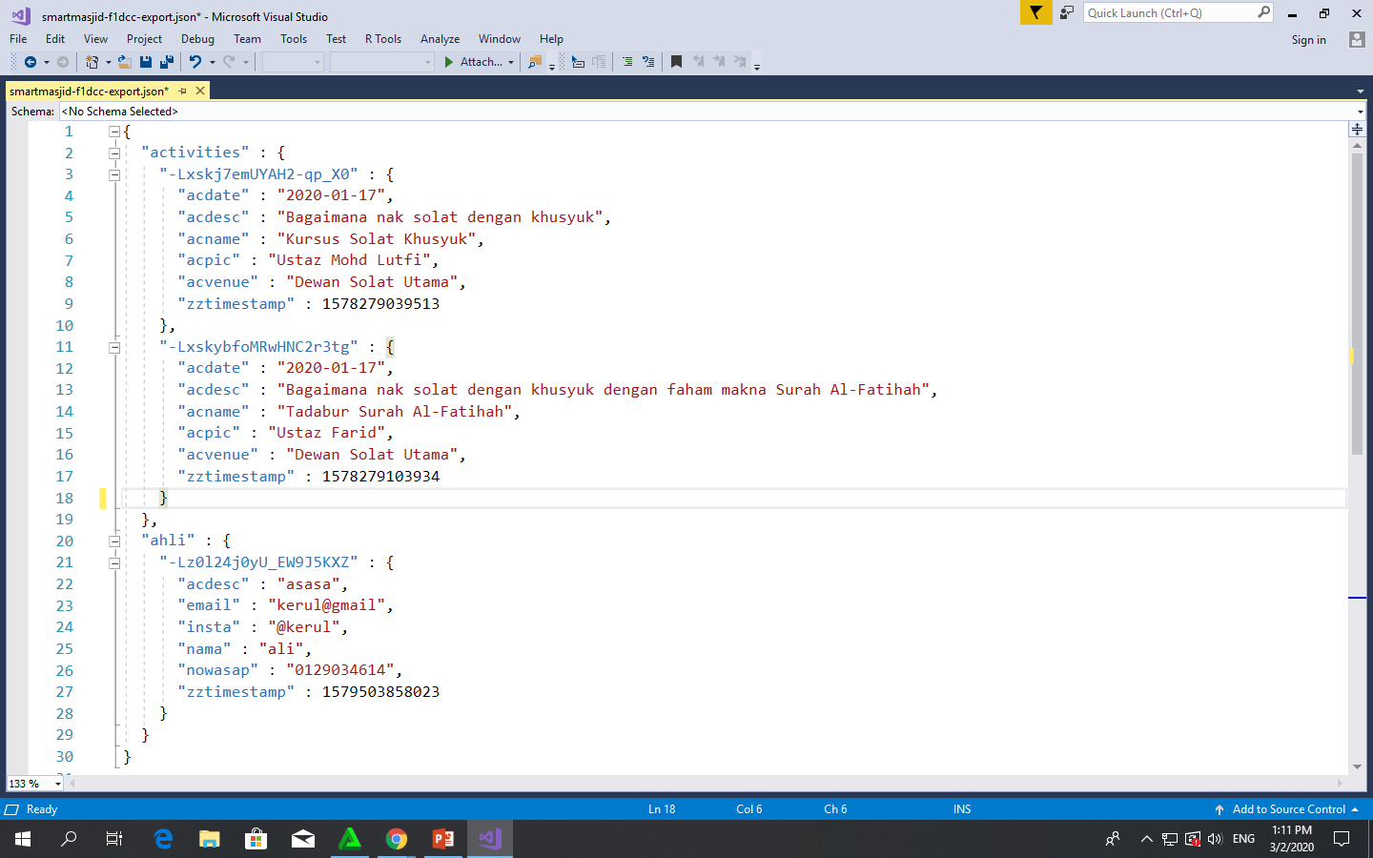
Play.google.com
JSON format example as applied in Firebase

Slide 132
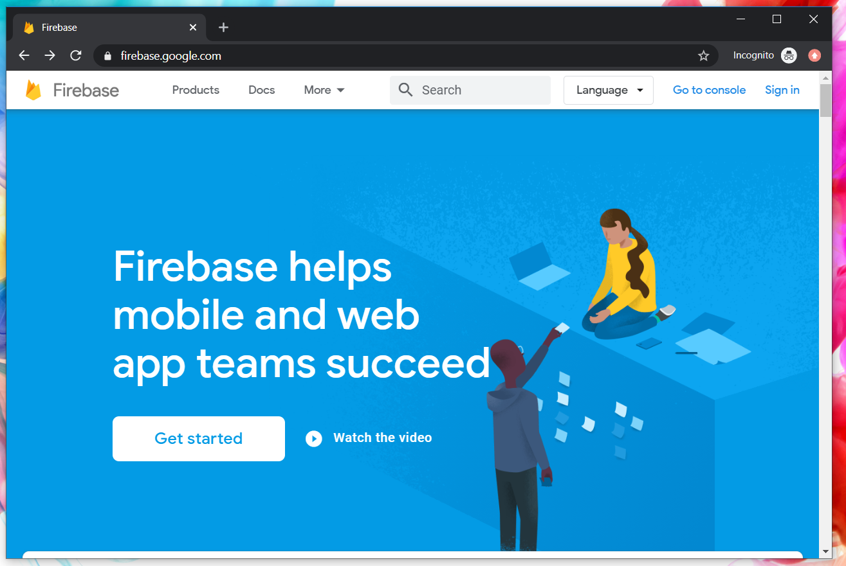
Google Firebase : Console
https://console.firebase.google.com/

Slide 133
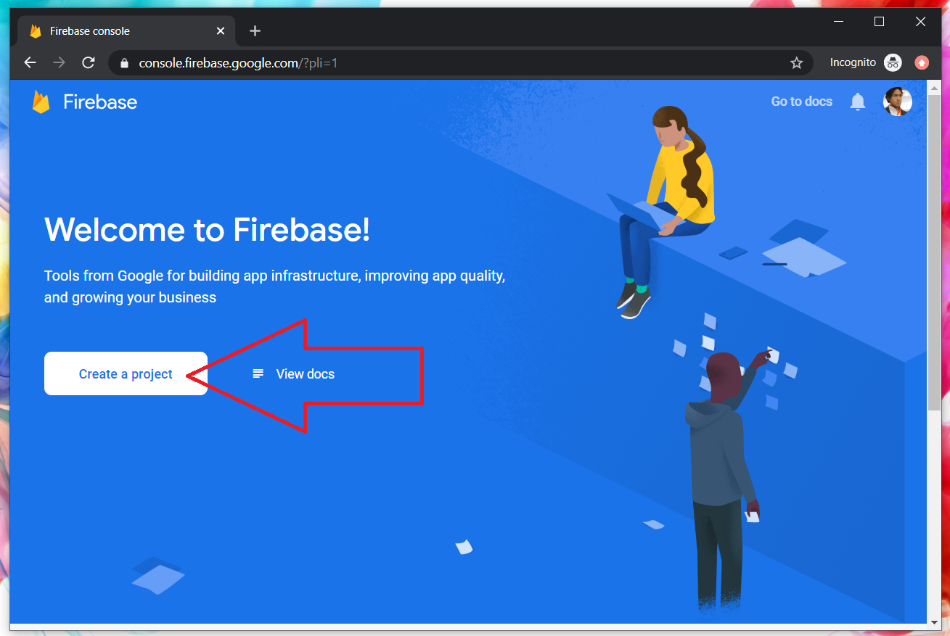
Google Firebase : Create new project

Slide 134
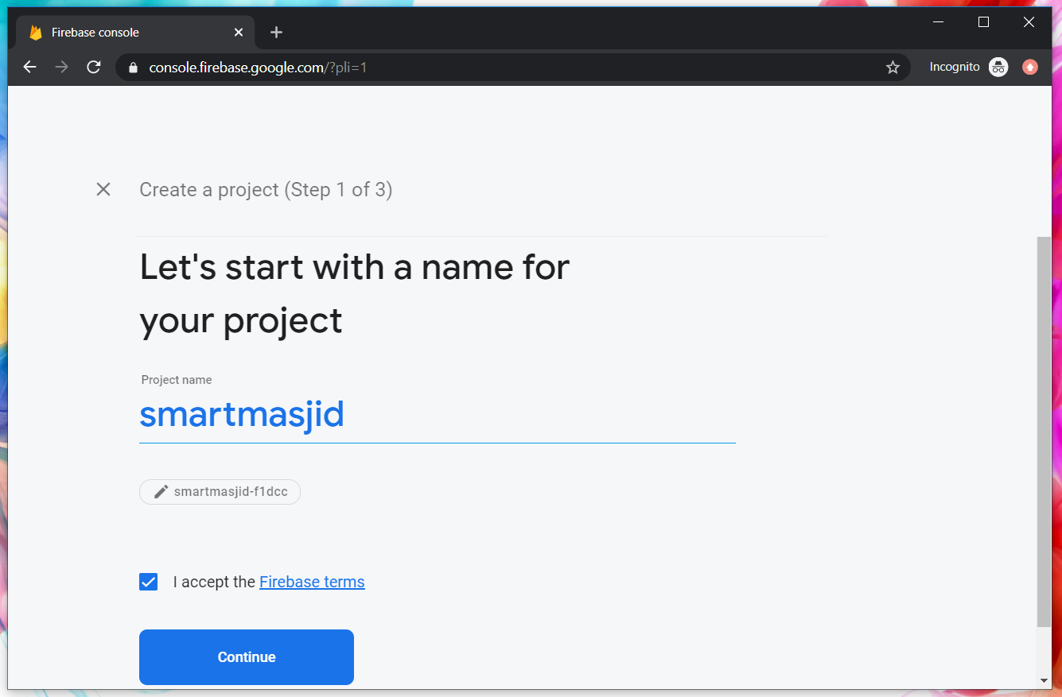
Google Firebase : Project name
sharefstm

Slide 135
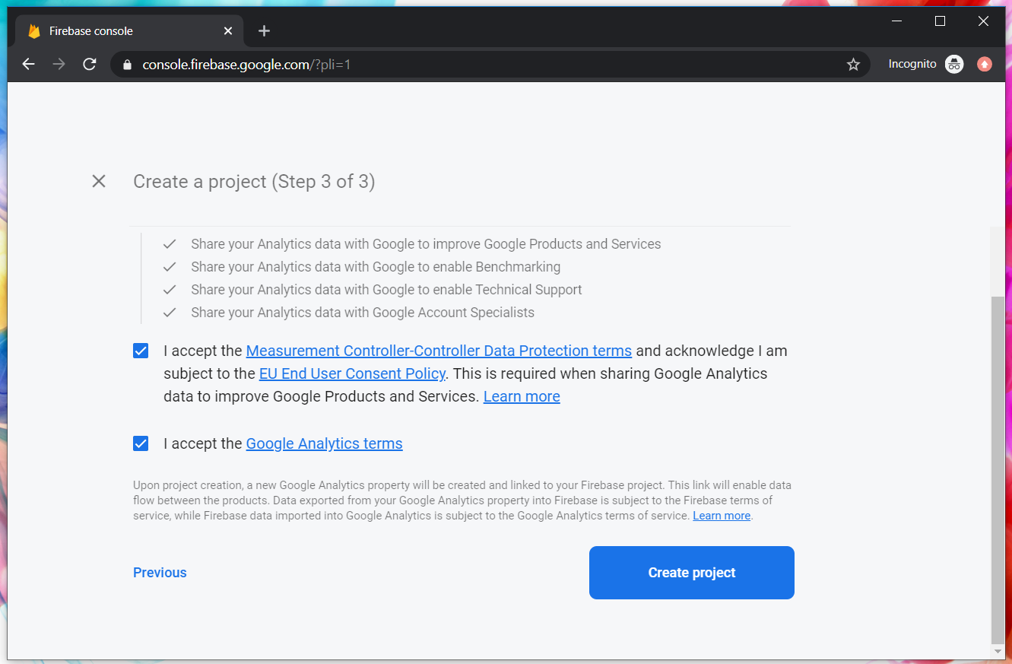
Google Firebase : Accept T&C

Slide 136
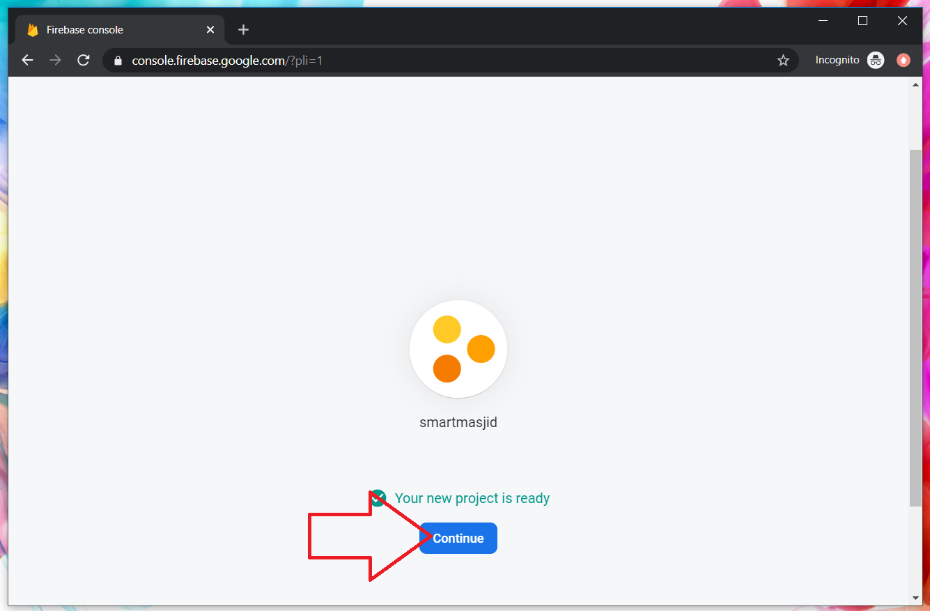
Google Firebase : Project ready and continue
makanapps

Slide 137
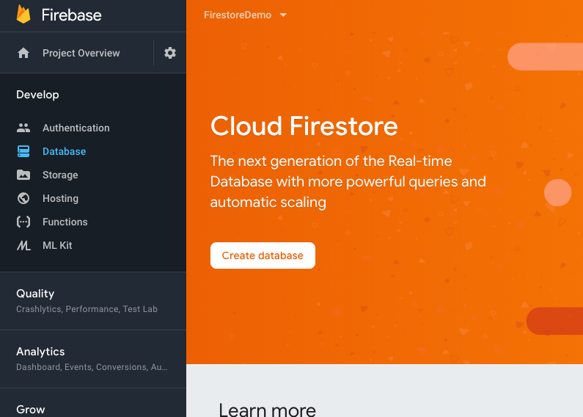
Google Firebase : Realtime database, automatic scaling

Slide 138

2
1
3

Slide 139

1
2

Slide 140

Google Firebase : Enable test mode

Slide 141

Google Firestore : add Firebase to app

Slide 142

Web Apps Firebase Configuration : Copy the highlighted

Slide 143

T11 Auth + Register
(daftar pengguna)

Slide 144

Create new Ionic project
ionic start sharefstm blank
Page 1: home

Slide 145

Filename src/app/home/home.page.html

Slide 146
Paste the Firebase configuration to environtment.ts
In environment.ts
…
export const environment : {
production: false,
firebaseConfig: {
apiKey: "AIzXXXXXXXXXXXXXXXWZMPN90HFrp4",
authDomain: "test-projeXXXXXXX.firebaseapp.com",
databaseURL: "https://test-projeXXXXXXX.firebaseio.com",
projectId: "test-projeXXXXXXX7",
storageBucket: "test-projeXXXXXXXX.appspot.com",
messagingSenderId: "446XXXXXX105"
}
};
…

Slide 147
Install AngularFirebase plugins
npm install firebase @angular/fire --save

Slide 148
Filename src/app/app.module.ts
//src/app/app.module.ts
…
//firebase & auth
import { AngularFireModule } from '@angular/fire';
import { AngularFireAuthModule } from '@angular/fire/auth';
import { environment } from '../environments/environment';
…
imports: [BrowserModule, IonicModule.forRoot(), AppRoutingModule,
//firebase & auth
AngularFireAuthModule,
AngularFireModule.initializeApp(environment.firebaseConfig),
…

Slide 149
Create globally accessible functions in folder services
ionic g service services/firebase
import { AngularFireAuth } from '@angular/fire/auth';
…
export class FirebaseService {
constructor(
private afAuth: AngularFireAuth
) { }
registerUser(email, password) {
return new Promise<any>((resolve, reject) => {
this.afAuth.createUserWithEmailAndPassword(email, password)
.then(
res => resolve(res),
err => reject(err))
})
}

Slide 150

Add another page
ionic g page daftar
Page 2: daftar

Slide 151

Filename src/app/daftar/daftar.page.html

Slide 152

Filename src/app/daftar/daftar.page.html

Slide 153

Filename src/app/daftar/daftar.page.ts

Slide 154

Filename src/app/daftar/daftar.page.ts

Slide 155


Slide 156
T12 Auth + Login
(pengesahan pengguna)

Slide 157
github.com/khirulnizam/ionic5 wasap.my/60129034614

Slide 158
Add globally accessible functions in folder services
ionic g service services/firebase
import { AngularFireAuth } from '@angular/fire/auth';
…
loginUser(email, password) { //function loginUser
return new Promise<any>((resolve, reject) => {
//authenticating with email & password
this.afAuth.signInWithEmailAndPassword(email, password)
.then(
res => resolve(res), //successful
err => reject(err)) //rejected
})
}//end loginUser
…

Slide 159

Add another page
ionic g page login
Page 3: login

Slide 160

Filename src/app/login/login.page.html

Slide 161

Filename src/app/login/login.page.html

Slide 162
Filename src/app/login/login.page.ts
…
cubalogin(email, password) {
this.fService.loginUser(this.email, this.password)
.then(res => {
console.log(res);
this.errorMessage = "";
//this.navCtrl.navigateForward('/dashboard');
}, err => {
this.errorMessage = err.message;
})
}//end cubalogin
…

Slide 163
github.com/khirulnizam/ionic5 wasap.my/60129034614

Slide 164


T13 Rekod Baharu
(insert new record)

Slide 165
github.com/khirulnizam/ionic5 wasap.my/60129034614

Slide 166

T14 Carian
(search records)

Slide 167
github.com/khirulnizam/ionic5 wasap.my/60129034614

Slide 168

T15 Kemaskini
(update record)

Slide 169
github.com/khirulnizam/ionic5 wasap.my/60129034614

Slide 170

T16 Padam
(delete record)

Slide 171
CRUD

Slide 172



Jana APK
(signed release)

Slide 173
Muatnaik Apps ke
Google Playstore
Fblive FSTM KUIS
11pg 6Nov 2020 (Jumaat)

Slide 174

←App ID

Slide 175

Play.google.com
Register for a developer ID
USD25 for life.
Another consideration: you need to pay through Google Wallet, using a credit card. https://play.google.com/apps/publish/

Slide 176
Playstore Graphic Materials
high-res icon. (size 512px x 512px)
Featured graphic. (size 1024px x 500px)
at least 2 non-Android TV screenshots. (2 screenshot images. Min length for any side: 320px)

Slide 177

Samples of graphic materials & signed bundle/APK

Slide 178
Graphic materials github.com/khirulnizam/ionic5

Slide 179



Slide 180


Ionic vs Flutter

